Slide 1
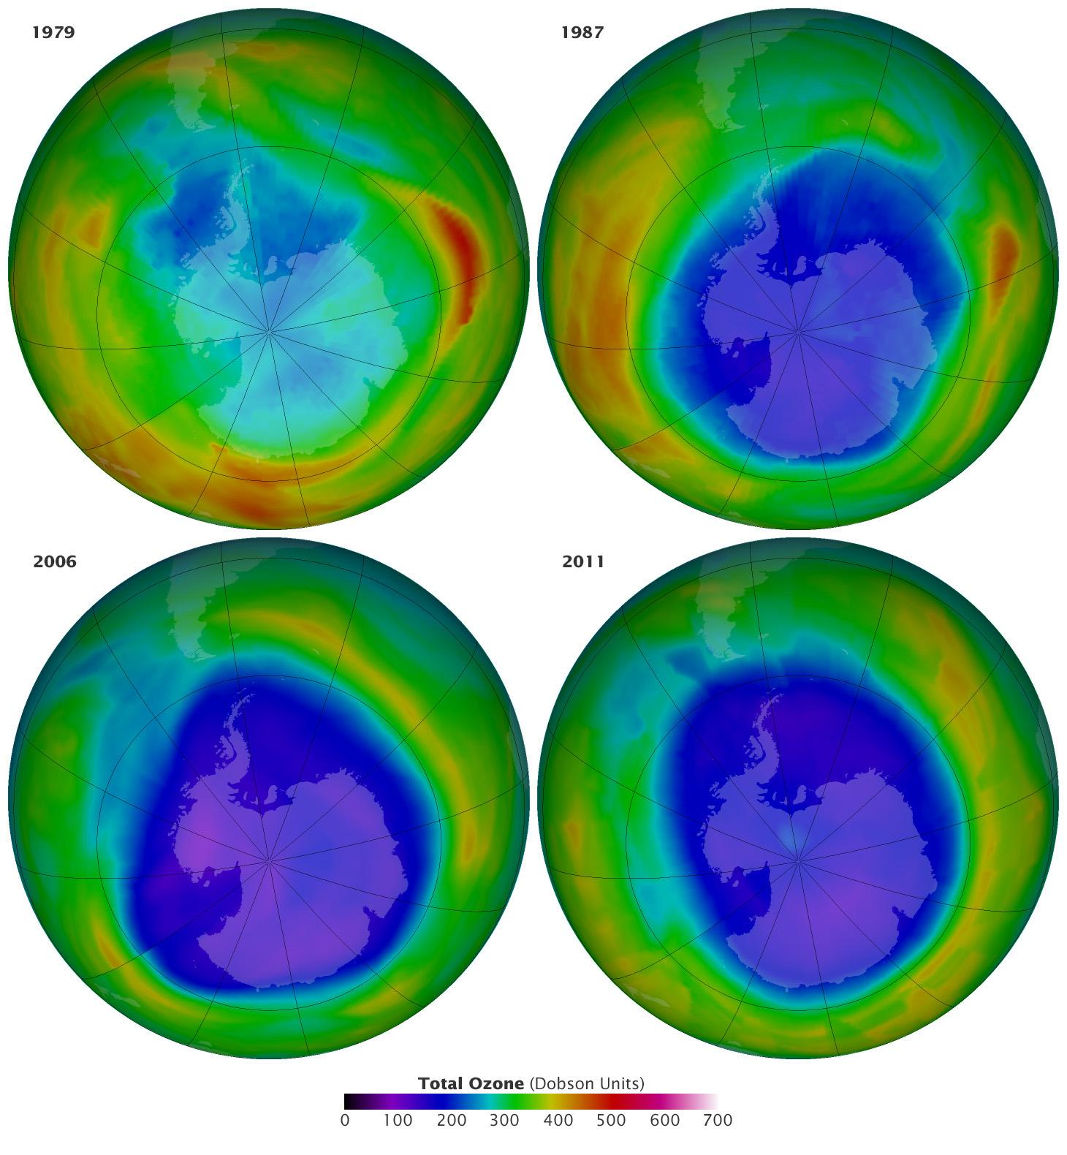
Ozone Depletion
Images by NASA on the status of the Antarctic Ozone Hole on September 16 of the years 1979,1987,2006& 2011

Slide 2
Ozone
About 90% of Ozone resides in the stratosphere
It protects us from UV radiations
Increase in the Troposphere ozone can contribute to raising global temperature
Ozone is continuously created in the stratosphere by absorption of UV radiation, while it is continuously being removed by various chemical reactions that convert it back to molecular oxygen

Slide 3
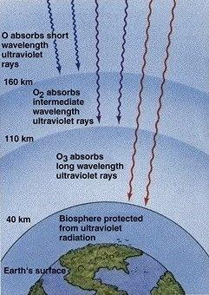
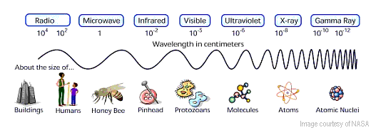

Slide 4
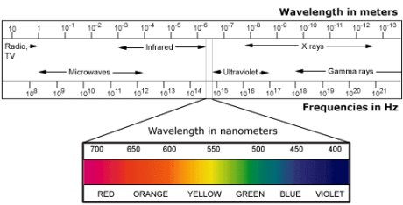

Slide 5
Classification of UV Rays
Name | Abbr. | λ range in nm | Energy/ photon (eV)
UV A, long wave, or black light | UVA | 400 –315 | 3.10–3.94
Near | NUV | 400 –300 | 3.10–4.13
UV B or medium wave | UVB | 315 –280 | 3.94–4.43
Middle | MUV | 300 –200 | 4.13–6.20
UV C, short wave, or germicidal | UVC | 280 –100 | 4.43–12.4
Far | FUV | 200 –122 | 6.20–10.2
Vacuum | VUV | 200 –100 | 6.20–12.4
Low | LUV | 100 –88 | 12.4–14.1
Super | SUV | 150 –10 | 8.28–124
Extreme | EUV | 121 –10 | 10.2–124

Slide 6
UV Skin Penetration
UVC and much of UVB rays are absorbed by the Earth’s ozone layer.
UVA and some UVB rays are transmitted through the atmosphere,
UVB rays (short wavelength) reach only the outer layer of your skin (the epidermis)
UVA rays (longer wavelength) and can penetrate the middle layer of your skin (the dermis).
Both Cause sunburns.

Slide 7
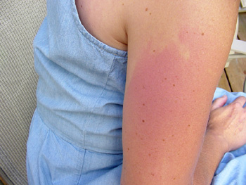
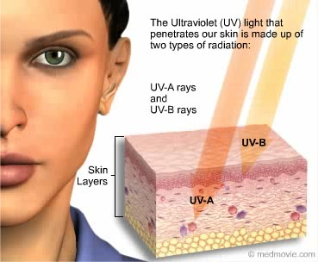
Sunburn—Skin damage due to UV

Slide 8
UVB radiation (280 - 320 ) has been linked to skin cancer, cataracts, damage to materials like plastics, and harm to certain crops and marine organisms. Although some UVB reaches the surface without ozone depletion, its harmful effects will increase as a result of this problem.

Slide 9
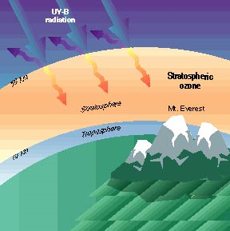

Slide 10
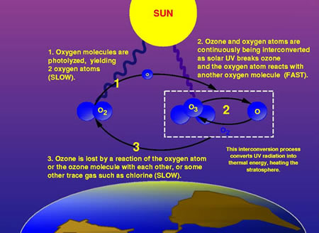

Slide 11
Natural Formation and Removal of Ozone
Ozone Formation:
O₂ + hν → 2 O*................ (λ< 240 nm)
O* + O₂ → O₃
Ozone Removal:
O₃ + hν → O* + O₂.............. ( 200 nm<λ<310)
O₃ + O* → 2 O₂
Catalytic Ozone Removal (by Cl, Br, OH*, NO*):
The catalysts can be anthropogenic or natural
Cl + O₃ → ClO + O₂
ClO + O₃ → Cl + 2 O₂.....catalyst regenerated.

Slide 12
Anthropogenic Ozone Depletion
Emission of chlorofluorocarbons and other ozone depleting substances.
These molecules are inert and non water soluble,
They are not destroyed through atmospheric chemical reactions in the troposphere or removed with precipitation.
They rise to the stratosphere and are broken down to yield Cl, Br. e.g.
CFCl₃ +hν → CFCl₂ + Cl
This results in a drastically higher concentration of ozone-destroying catalysts (Cl, Br) in the stratosphere.
Accelerates the catalytic destruction of ozone.
A single chlorine molecule can break down tens of thousands of ozone molecules before it gets deactivated.

Slide 13
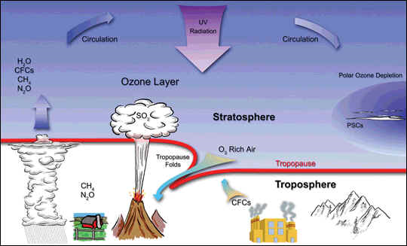
Ozone Depletion

Slide 14
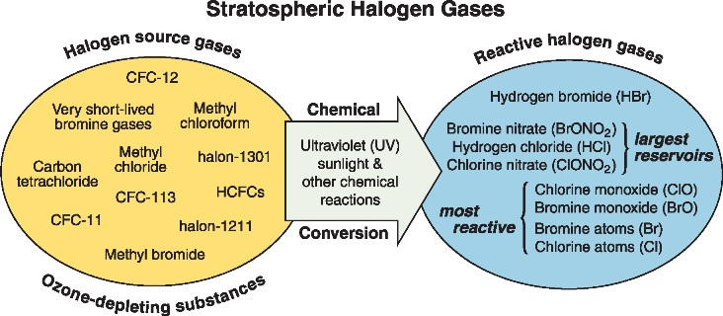

Slide 15
Chemical | Application | O₃ Dep. Pot.
CFC | Stable in troposphere. Rise to the stratosphere, break down in presence of UV-B and attack O₃. | 0.6-1
CCl₄ | Wide industrial uses: CFC manufacture, solvent and catalyst. Potent carcinogen. | 1.2.
Halons | Contain Br, F, C. Fire extinguishing agent. Production Stopped in the U.S. ended on 12/31/93. Br is many times more effective at destroying ozone than Cl
HCFC | CFC-replacements. Lesser depletion potential. | 0.01- 0.1.
HFC | CFC replacements. Because they do not contain chlorine or bromine, they do not deplete the ozone layer. | 0.
MeBr | CH₃Br Methyl Bromide. Pesticide for soil and many agricultural products. Production stopped in the U.S. on 12/31/2000. | 0.6.
CH₃CCl₃ | Methyl Chloroform. Industrial solvent. | 0.11.
HBFC | Hydrobromofluorocarbon Class I substances.

Slide 16
Chlorofluorocarbons
CFCs can last in stratosphere > 100 yr.
Production ban since December 31, 1995.
Only recycled and stockpiled CFCs can now be used on a limited basis.
CFCs are also a “greenhouse gas”
Class I substances have an ozone-depletion potential of 0.2 or higher. These include CFCs, halons, carbon tetrachloride, methyl chloroform, HBFC and methyl bromide.

Slide 17
Hydrochlorofluorocarbons
HCFCs and hydroflurocarbons (HFC) are safer.
Less stable in the atmosphere
Less likely to reach the stratosphere to affect the ozone layer.
HFCs even lack Cl and hence are safer.
But HCFCs an HFCs are highly potent greenhouse gasses.

Slide 18
Measurement of Ozone: Dobson Unit
Measurement of stratospheric ozone columnar density: Dobson unit (DU)
Gordon Dobson, University of Oxford researcher.
1920s, he built the Dobson ozone spectrophotometer.
1 DU = a layer of ozone that would be 10 µm thick under standard temperature and pressure. 2.69×10¹⁶ ozone molecules/ sq. cm
300 DU of ozone brought down to the surface of the Earth (atmospheric pressure) at 0°C would occupy a layer only 3 mm thick.
Ozone hole: Layer < 220 DU

Slide 19
Global warming and Ozone –Depletion impacts of CFCs
Fully halogenated CFCs have long atmospheric lifetimes,
They contain relatively large amounts of chlorine
They absorb strongly within the 7 to 13 micron atmospheric window
Therefore, they have considerable potential for both global warming and ozone depletion.
They are 15000 times potent than carbon dioxide when compared to carbon dioxide!

Slide 20
India & CFC's
According to UNEP, in 2008, India produced almost all the CFC in the world, and the amount it officially exported was far lower than the amount reported by other countries to be imported from India.
However, CFC's are still the most smuggled commodity, next to drugs.
India and South Korea are the two major manufacturers that still produce CFC's, but are sold on the black market.

Slide 21
In 2008, UNEP estimated these two countries accounted for over 70 per cent of global CFC production, which has come down from a million tonnes a year to 50,000.
All developed nations have already banned CFC production, and India officially banned CFC's in late 2008, after signing the Montreal Protocol.

Slide 22
Homogenous and Heterogeneous Ozone Depletion
Homogeneous:
the depletion occuring more or less uniformly all over the globe (in the statosphere.
Heterogeneous: Ozone hole
Excessive depletion of the ozone layer above the poles especially during the spring season.
(http://www.epa.gov/ozone/science/hole/whyant.html)

Slide 23
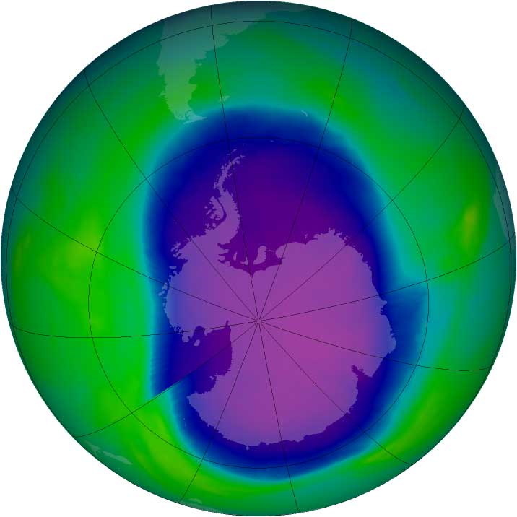
Ozone Hole
Largest observed ozone hole, September 21-30 Sept, 2006 (10.6 mi. sq miles). The blue and purple colors are where there is the least ozone, and the greens, yellows, and reds are where there is more ozone. Credit: NASA
Watch NASA video on Ozone Depletion

Slide 24
Antarctic Ozone Hole
In the 3-month long dark polar winter, the Polar Vortex develop (http://science.nasa.gov/headlines/y2000/ast02oct_1.htm)
It is more pronounced in the southern hemisphere due to fewer land masses.
It traps and chills the polar stratosphere to <–80 °C.
Polar Stratospheric Clouds (PSCs) form at these temperatures.
Chlorine accumulates on these ice crystals in the form of reservoir compounds like ClONO₂, HOCl
Cl + O₃ → ClO + O₂
ClO + NO₂ → ClONO₂

Slide 25
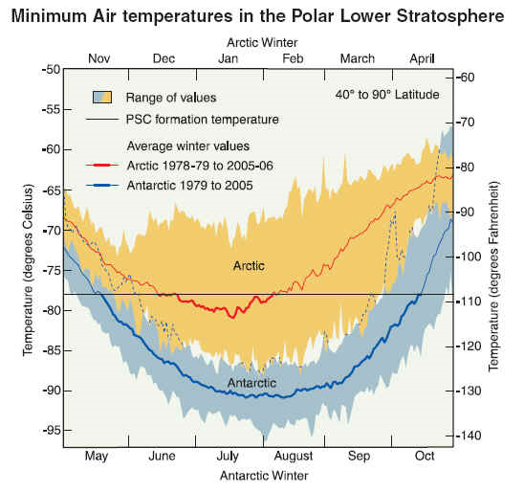

Slide 26
Antarctic Ozone Hole
In the spring, solar radiation triggers the release of massive quantities of Cl from the reservoir compounds.
The released Cl causes a rapid catalytic degradation of ozone in a short span.
This leads to the formation of the ozone hole.
By mid-December (in the Antarctic), the polar vortex breaks up, PSCs disappear, and ozone from lower latitudes comes in and the ozone hole shuts down.

Slide 27
Temporal status of Ozone
Year | Area of O₃ Hole (in million km²) | Concentration of O₃ (in DU)
1979 | 11.1 | 194
1987 | 22.4 | 109
2006 | 29.6 | 84
2011 | 26 | 95
Credit: https://earthobservatory.nasa.gov/IOTD/view.php?id=79198
Images by NASA on the status of the Antarctic Ozone Hole on September 16 of the years 1979,1987,2006& 2011

Slide 28
Montreal Protocol on Substances that Deplete the Ozone Layer
International treaty with a mission to protect Ozone layer by regulating production of ozone-depleting substances (ODSs)
It was initiated on 16 September 1987, and entered into force on 1 January 1989; 197 countries participated in the ratification process thereafter
It is believed that if the international agreement is adhered to, the ozone layer is expected to recover by 2050.
“Perhaps the single most successful international environmental agreement to date has been the Montreal Protocol” Kofi Annan (Former Secretary-General of the United Nations)

Slide 29
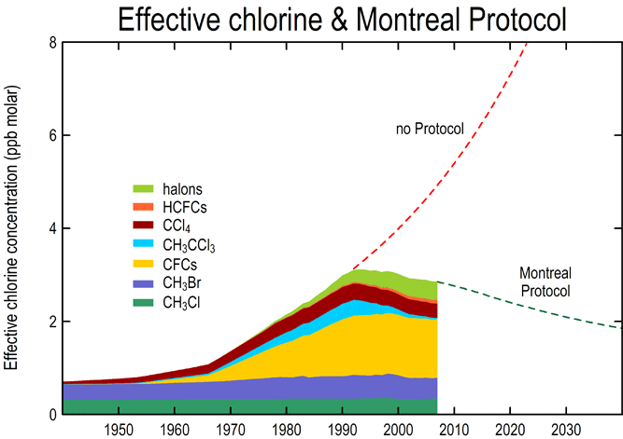
How has the Montreal Protocol been a success story?
The treaty with the international cooperation has effectively phased-out the production and consumption of several major Ozone Depleting Substances (ODSs) in the lower atmosphere and in the stratosphere, enabling staratospheric ozone recovery.
Graphical illustration by CSIRO Marine and Atmosphere Research on global impact of the Montreal Protocol on the levels of ODSs in the atmosphere, and suggest the impact by 2050

Slide 30
Never doubt that a small group of
thoughtful, committed citizens
can change the world indeed
it’s the only thing that ever has
- Margaret Meed

Slide 31
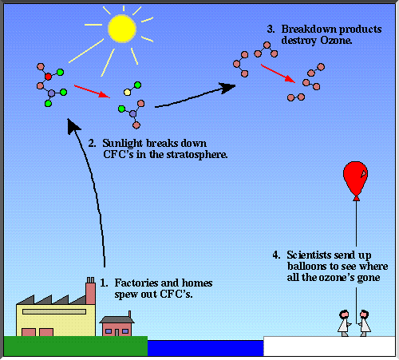
Extra slides

Slide 32
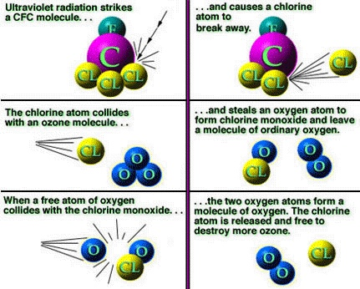
How ozone is destroyed by CFCs

Slide 33
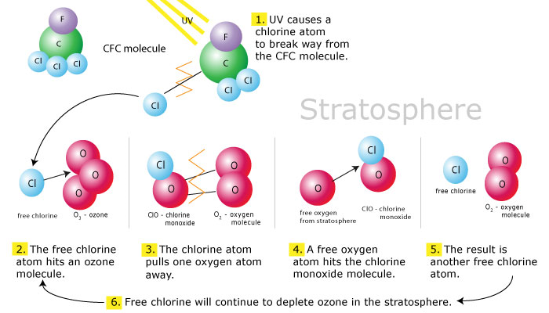

Slide 34
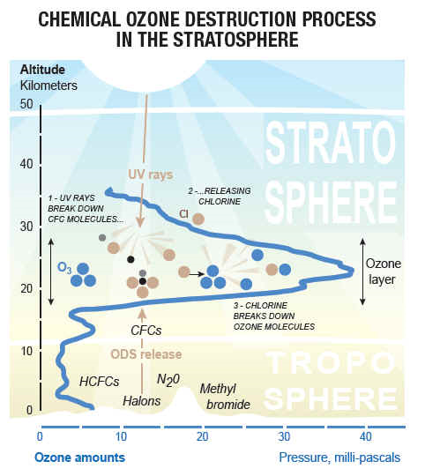

Slide 35
Ozone layer as protective shield
Atomic oxygen is produced by the photolytic decomposition of molecular oxygen
O2 + hν O + O
Atomic oxygen, in turn, reacts rapidly with molecular oxygen to form ozone
O + O2 + M O3 + M
where M represents a third atom (Nitrogen or oxygen)
Ozone removal by photo dissociation
O3 + hν O2 + O

Slide 36
H₂O + ClONO₂ HOCl + HNO₃
The sun light frees Cl from HOCl by photolysis
HOCl + hυ Cl + OH
Cl + O₃ ClO + O₂
OH + O₃ HO₂ + O₂

Slide 37
Impacts of other greenhouse gases
Methane helps to remove ozone destroying chlorine
Cl + CH₄ HCl + CH₃
CH₃ + O₂ CH₃O₂
CH₃O₂ + NO CH₃O + NO₂
NO₂ + hυ NO + O
M + O + O₂ O₃ + M

